Slide 1
Holyrood RC Secondary
SILVER: Rights Aware
What have we been doing?

Slide 2
We were awarded SILVER: RIGHTS AWARE in August 2022 and are now aiming for GOLD!

Slide 3
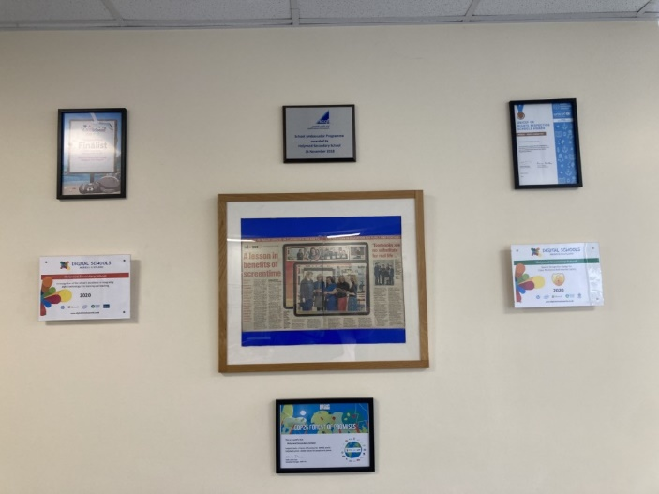
Our Silver Award, pride of place in our Foyer

Slide 4
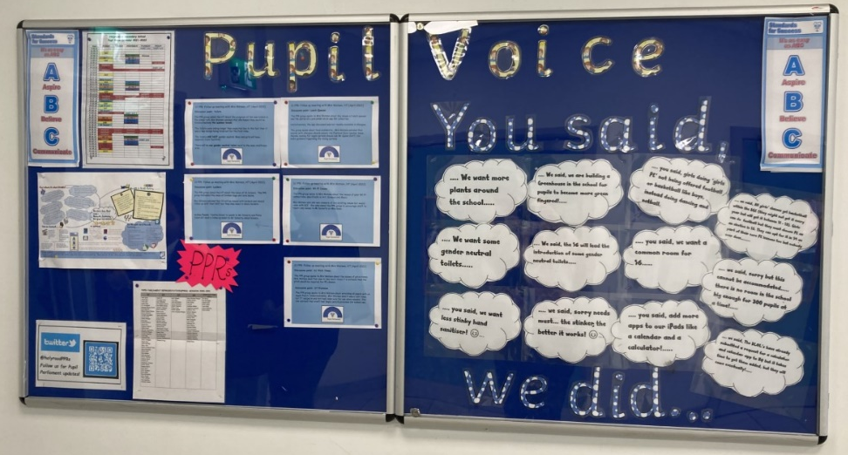
Our noticeboards around the school

Slide 5
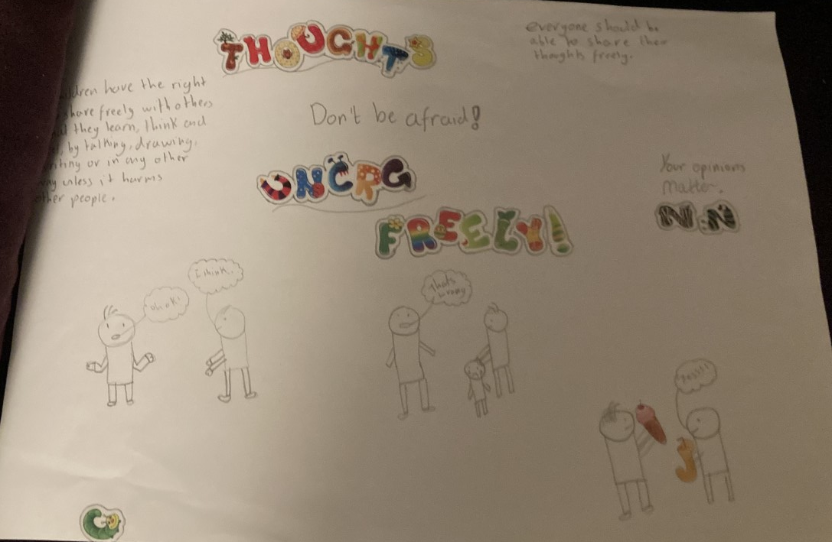
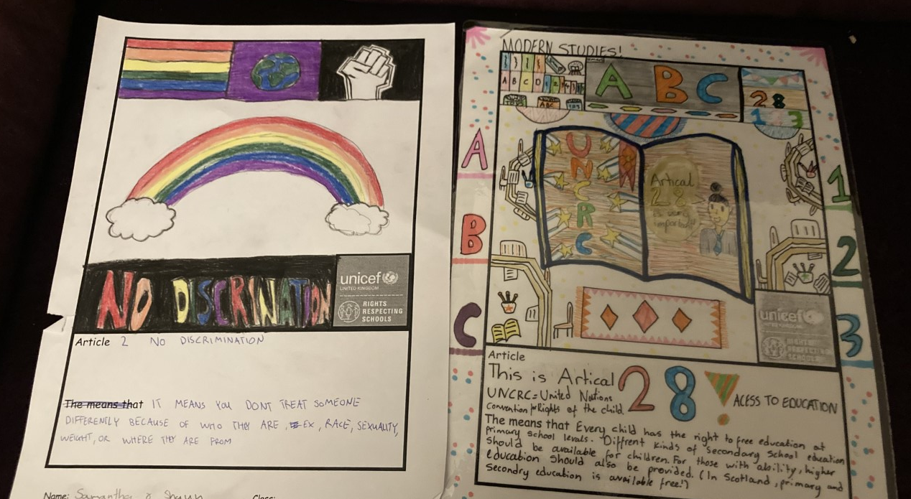
Examples of Rights Based Learning

Slide 6
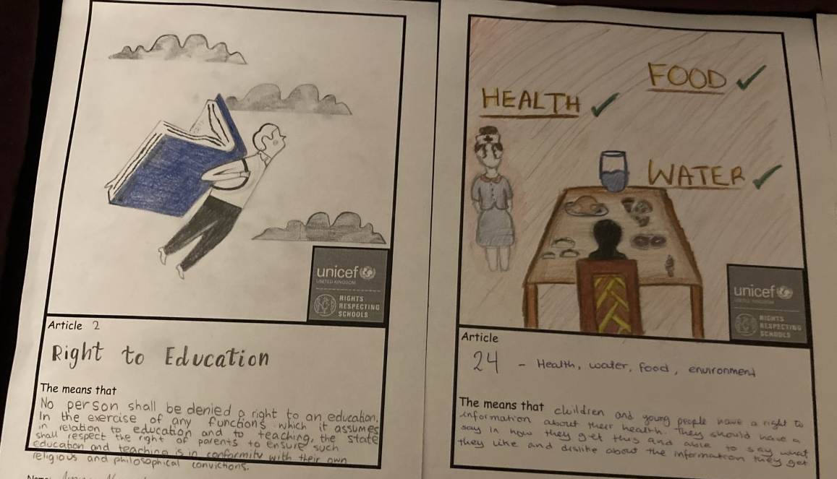

Slide 7
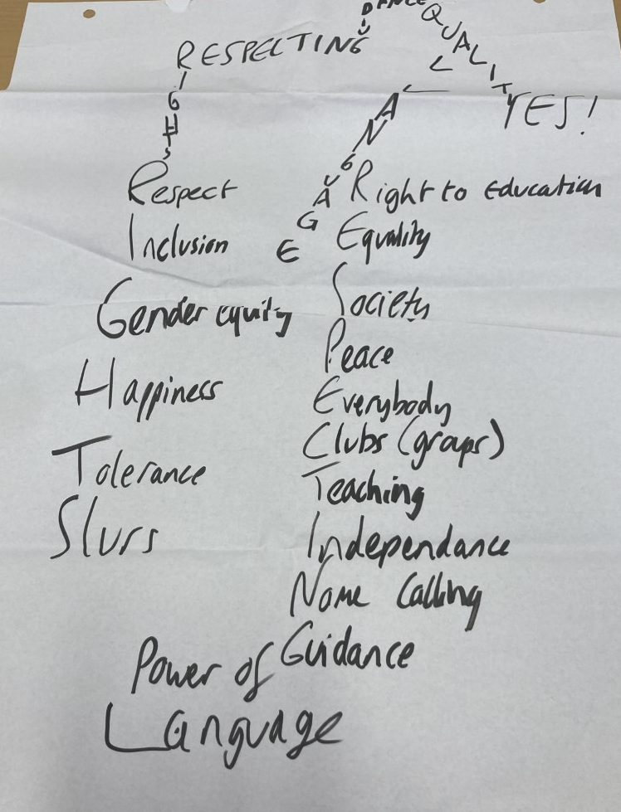
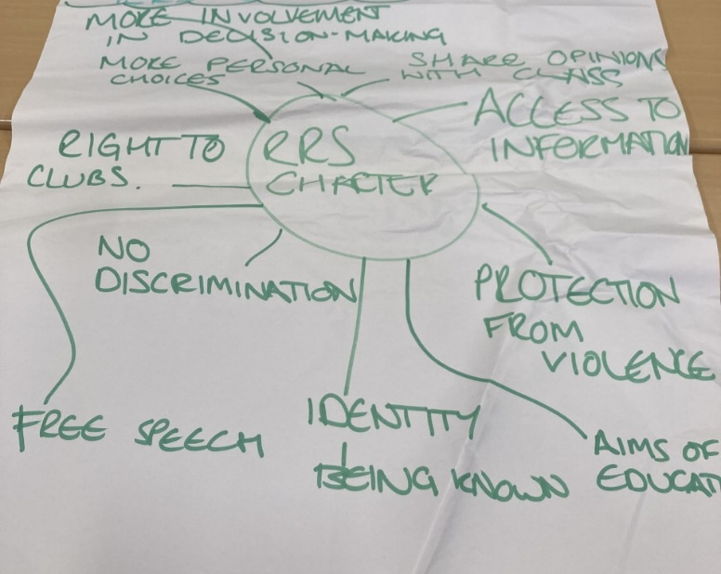
Some notes from meetings with young people asking their opinions of what a Rights Respecting
School should be…

Slide 8
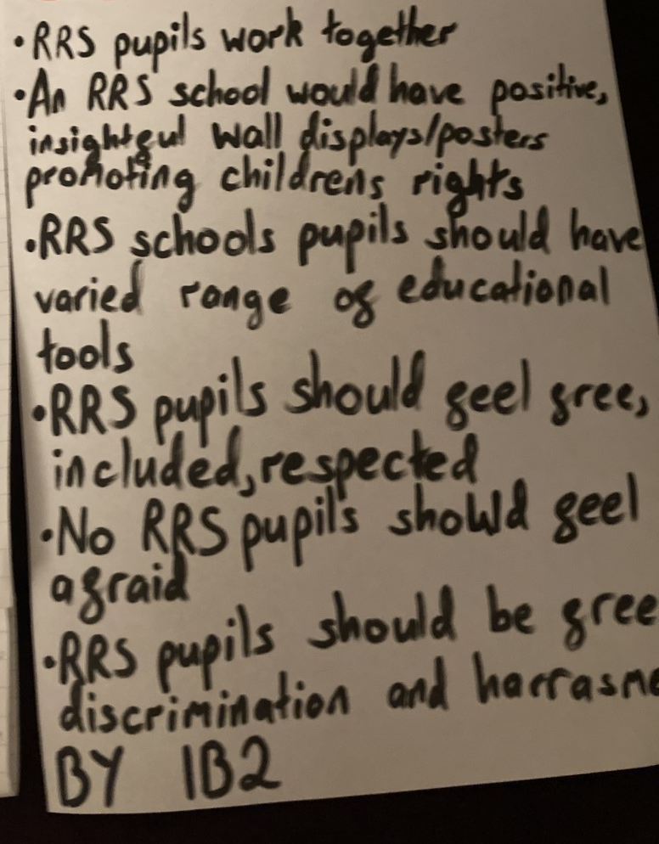
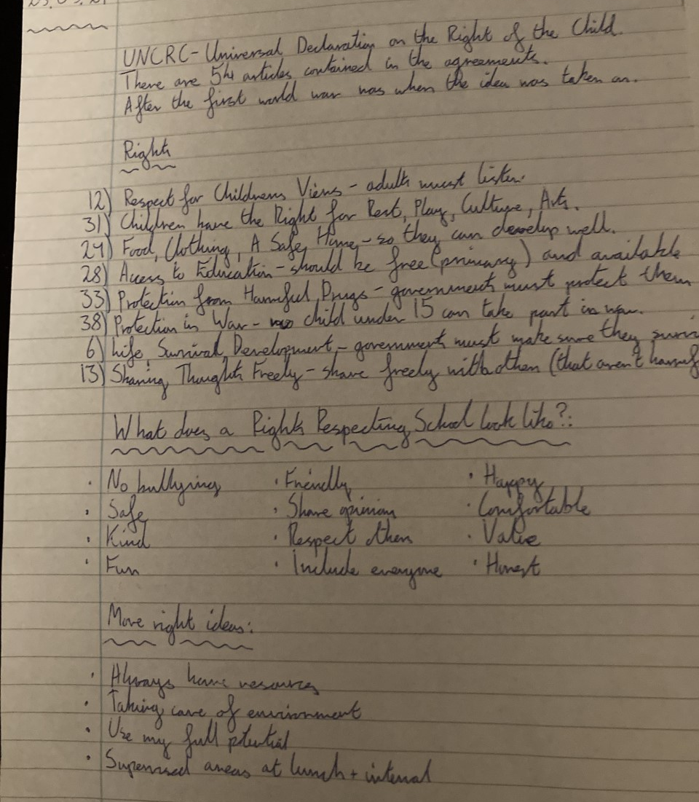

Slide 9
Staff and young people were involved in the development of our new Standards for Success Policy.

Slide 10
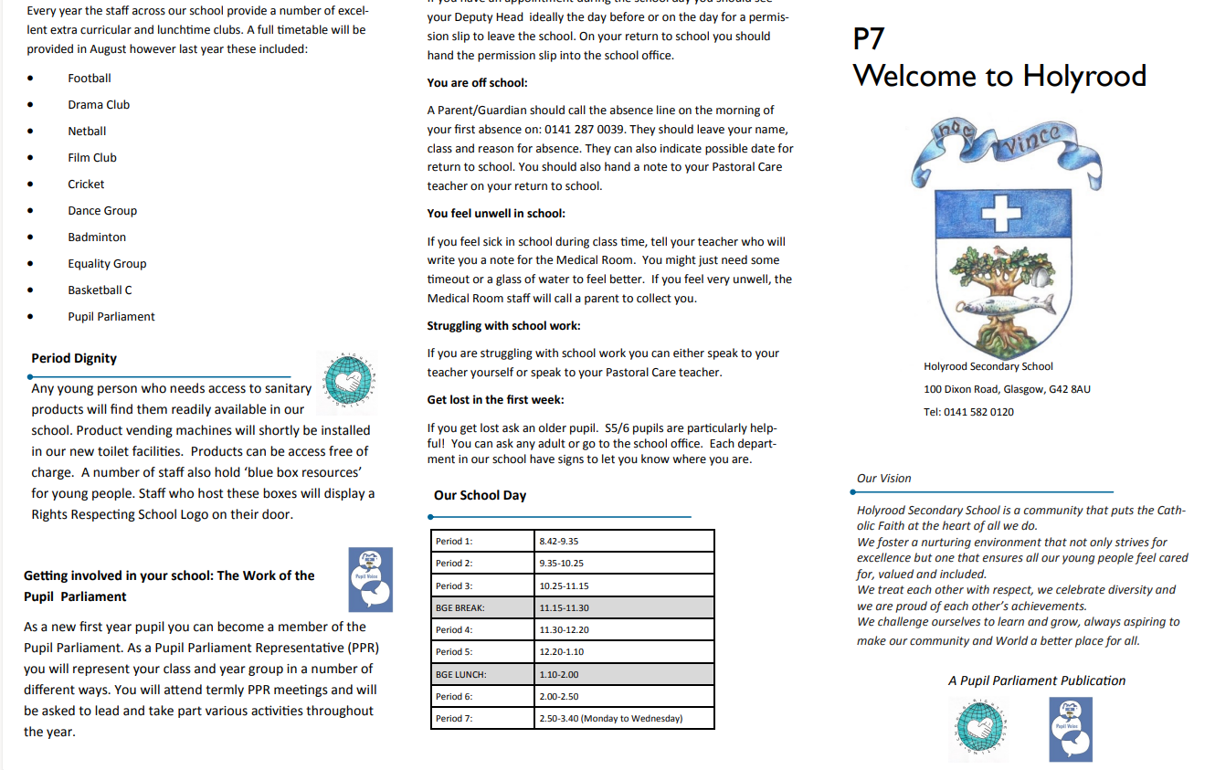
Leaflet developed by the PV, PP and RRS teams to provide a welcome information leaflet for new S1 Pupils.
https://sway.office.com/memDyQnIjlFA9NZw?ref=Link

Slide 11
Interactive Inclusive School Signage
Developed after consultation with young people.
Pupils can now use their iPads to find their location within the school. Scanning the QR codes to access spoken directions in English and a selection of our other languages and a sign language visual.
https://sway.office.com/memDyQnIjlFA9NZw?ref=Link

Slide 12
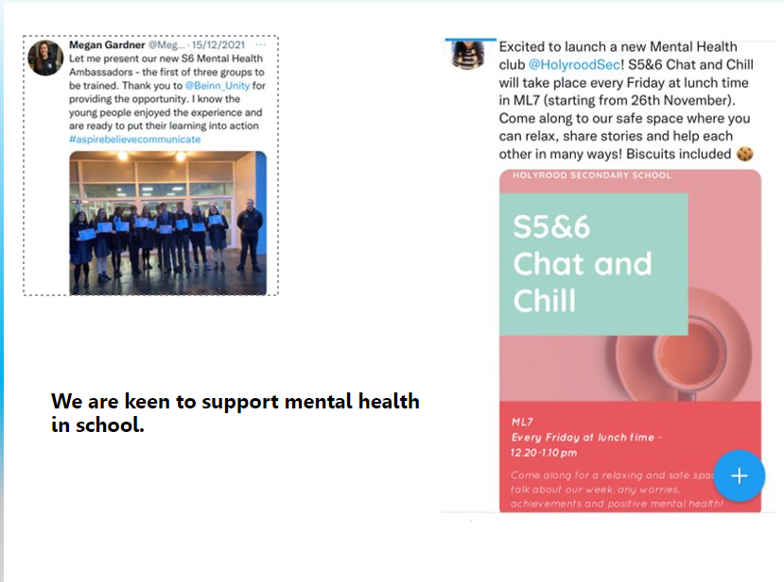
Establishment of the Mental Health Ambassadors scheme, with Senior pupils trained to support other pupils with their mental health.

Slide 13
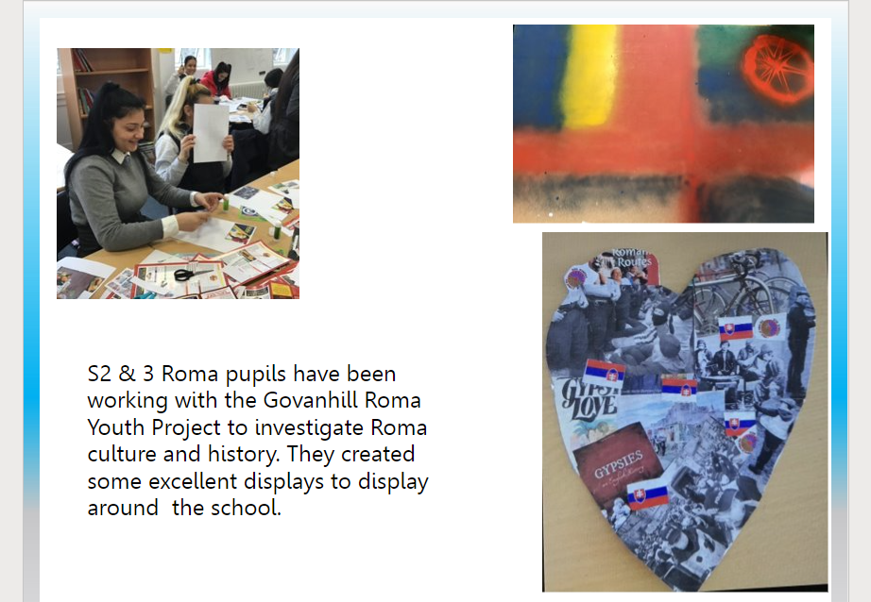
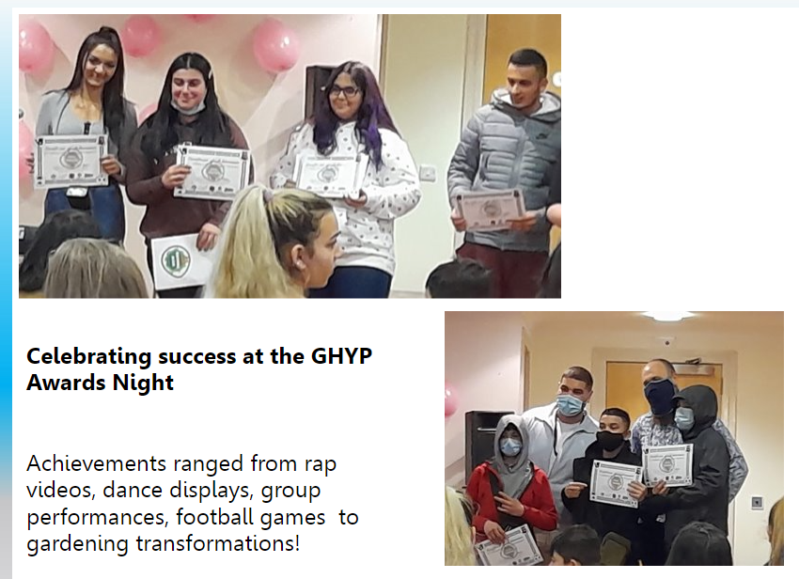
Working in partnership with the Govanhill Roma Youth Project

Slide 14
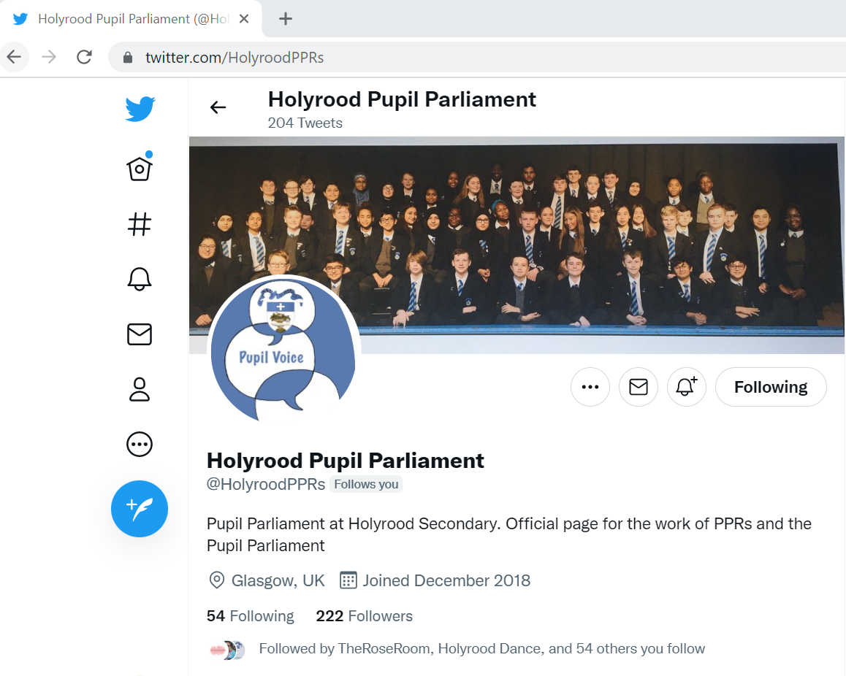
Our PV Boxes located around the school and available online
https://twitter.com/HolyroodPPRs

Slide 15
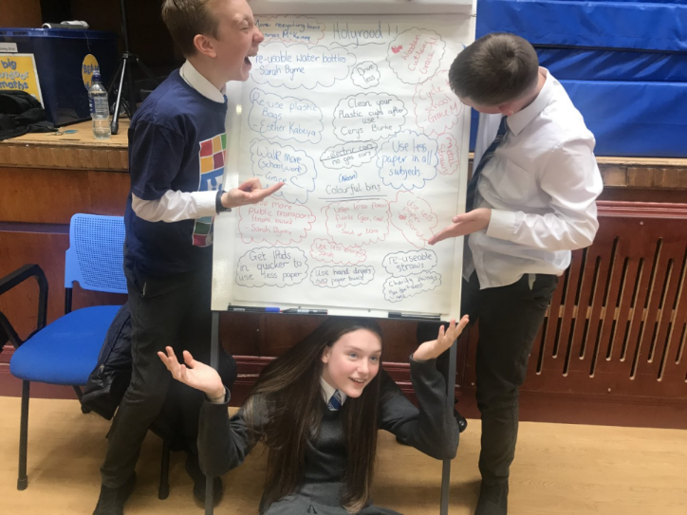
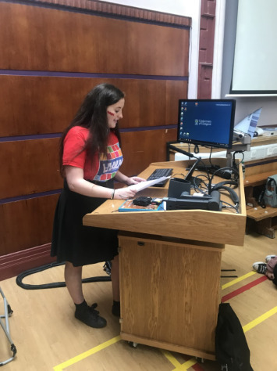
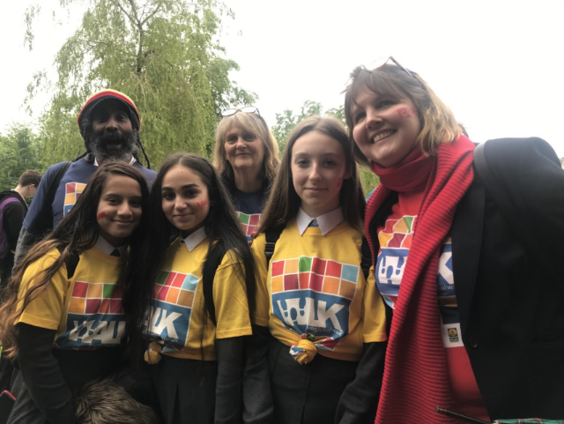
We’ve taken part in campaigns such as
‘Walk the Global Walk’ campaign

Slide 16
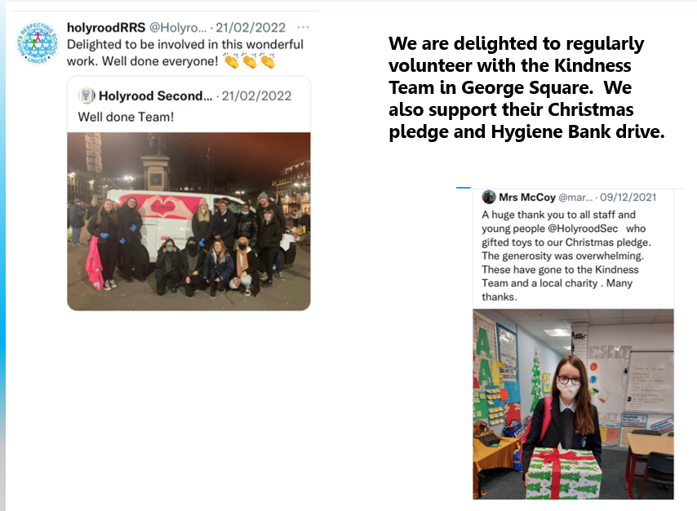
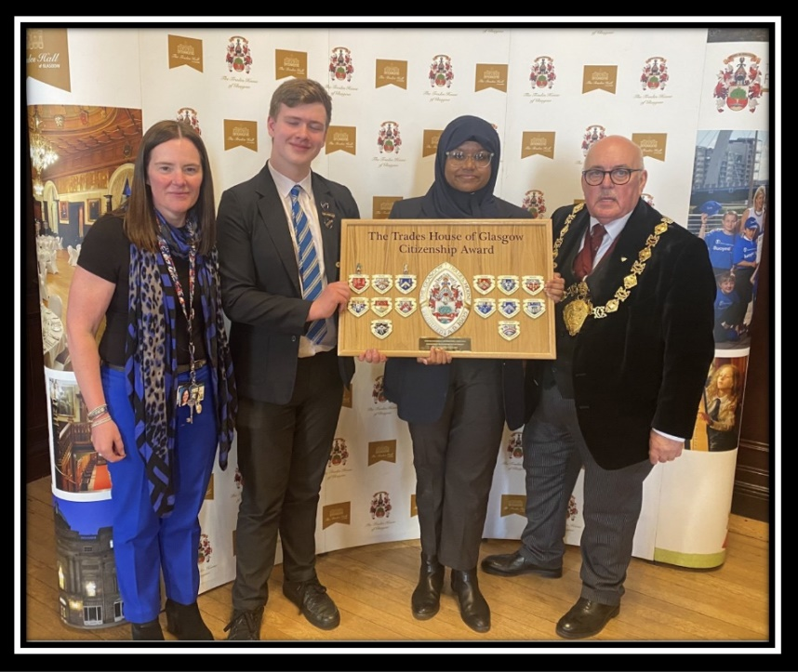
We were delighted to be crowned winners of the Trades House of Glasgow Citizenship Award 2022 for our volunteering and work in the community.

Slide 17
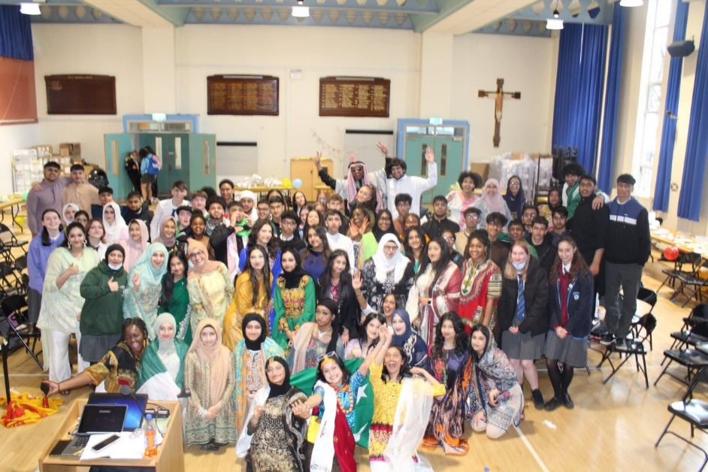

Slide 18
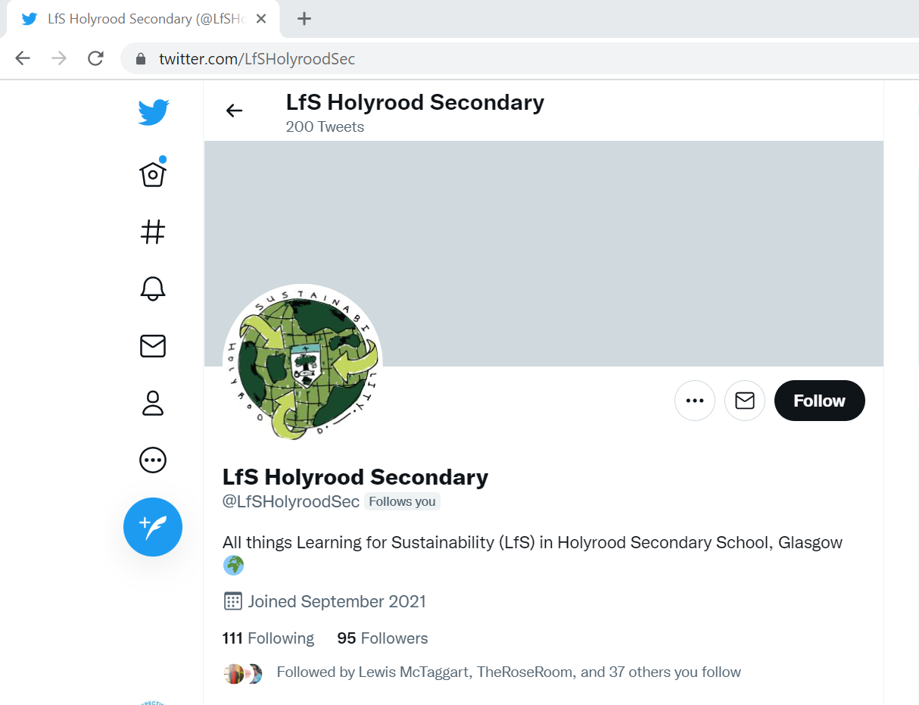
We are very proud to have an active
Learning for Sustainability group in Holyrood
https://twitter.com/LfSHolyroodSec

Slide 19
We need you to become involved!
As part of our Going for Gold campaign we need volunteers.
We intend to do the following:
Article of the Week tannoys
Help teachers to ‘adopt’ a right for their classroom
Decide on a campaign for this year
Notes:
These are optional videos you might like to show:
Unicef smiles from 2016
- A video about Unicef and children’s rights made by a Year 8 child.

Slide 20
Rights Respecting Schools
Help shape the RRS strategy in the school and become a Rights Ambassador.
We gained our ‘Silver status’ this year and are currently working towards our ‘Gold status’.
If you are interested then please contact Miss Wilson or use the teams code to join.
o6pac1h

Slide 21
Our Affiliated Groups

Slide 22
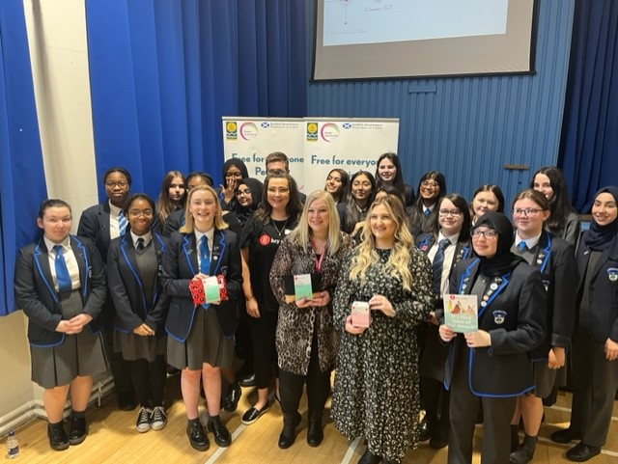
Period Dignity Group
Join our Period Dignity Group(PDG).
This group ensure that every young person has access to period products.
It also has plans to educate young people in Holyrood about the law surrounding period products and how they should be accessed.
We also hope to run a number of pupil health sessions for young people in our school.
If you are interested then please contact Mrs Ford or use the teams code to join.
zn1ywtp

Slide 23
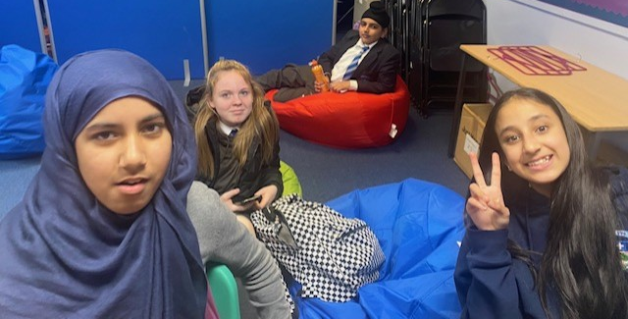
VIP Room
Be a volunteer for the hugely successful VIP room.
The VIP room is situated in the conference room during BGE lunch and relies on Senior Volunteers.
If you are interested then please contact Mrs Ford or use the teams code to join.
As part of your volunteering you will be able to earn a Higher Leadership Award.
wm5yscu

Slide 24
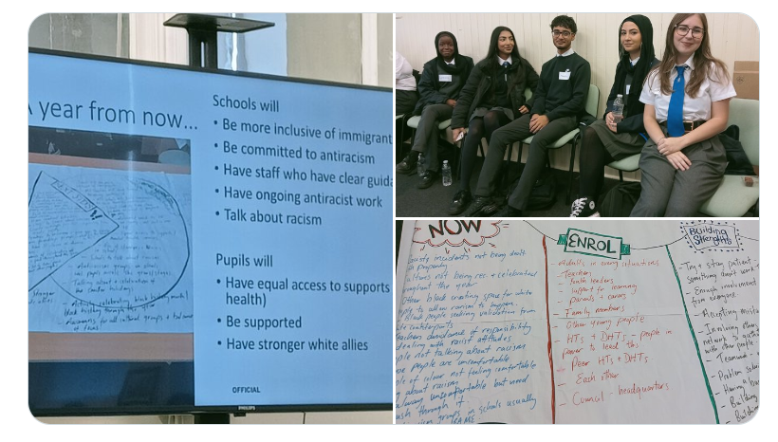
Anti Racism Alliance in Holyrood
We are a new group in Holyrood, keen to tackle racism
and inequality.
We intend to celebrate important dates such as Black
History Month and World Hijab day.
We hope to continue our S6 Cultural Diversity
celebrations and to raise awareness of Ramadan
and its importance in our local community.
Some of our members were lucky enough to
take part in the recent Glasgow City Council
‘Building an Anti Racist School’ event.
We have lots of plans for the year ahead and
hope to welcome more members.
Please see Mrs Cooper or Miss Wilson for details.

Slide 25
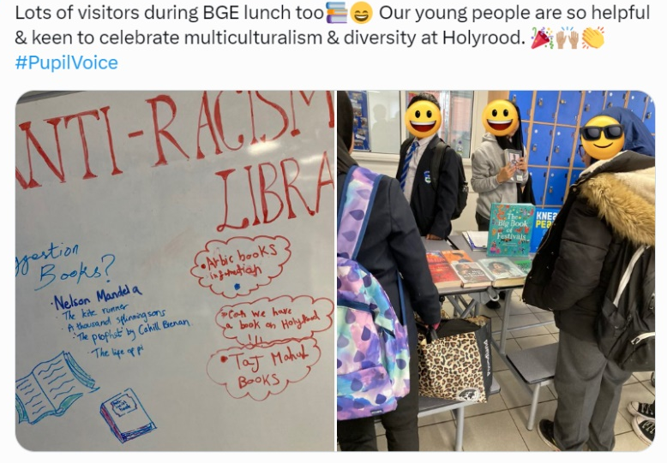
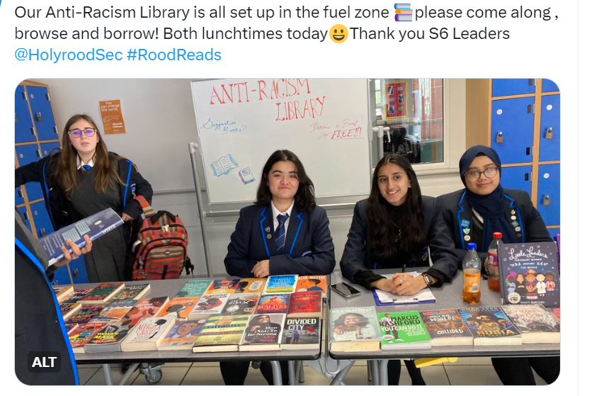
Anti Racism Alliance in Holyrood
We are working with Mrs Kindness,
our Librarian to develop our Anti Racism
library and hope to develop a whole
school Anti Racism pledge.

Slide 26
Anti Racism Alliance in Holyrood
We worked with the RRS team to produce our new Equalities Policy.
We have decided on three areas of focus:
Equality Objective 1:
To raise awareness and understanding of gender equality in all areas of school life.
Equality Objective 2:
To raise awareness and understanding of racial equality in all areas of school life.
Equality Objective 3:
To promote positive mental health and wellbeing.

Slide 27
Cost of the School day
We are a new group, set up to tackle the rising costs of the school day.

